Slide 1
Digital Logic Design and Application Lecture #09
UESTC, Spring 2020

Slide 2
Topic 2-1 combinational circuits design
Principles
Applications
Logic levels and Gates
Standard Combinational components
Verilog for combinational circuits
Switching Algebra
logic functions
combinational circuit analysis and design
Chap. 3.6

Slide 3
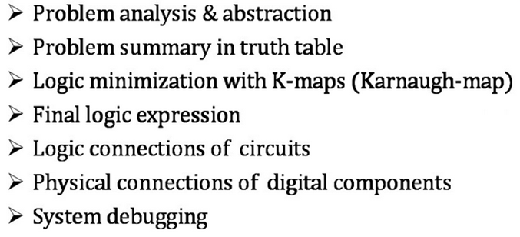
Traditional digital design
Before PLDs traditional digital design was mostly done manually.
Methodology: Truth table →logic equations
Hardware: Gates → building blocks (standard components) → systems
Draw backs: Complicated, hard to debug, inefficient to design
Traditional digital design process

Slide 4
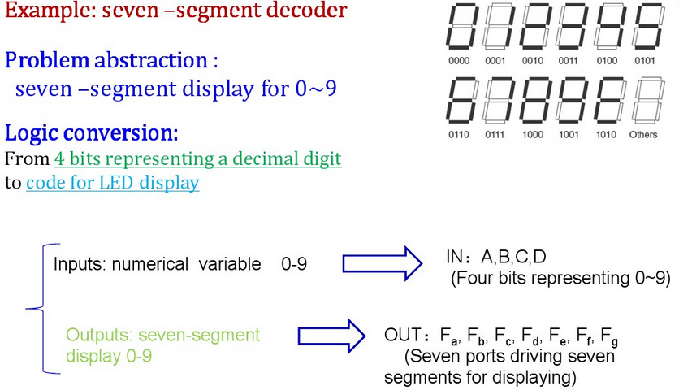
Traditional digital design
P93

Slide 5
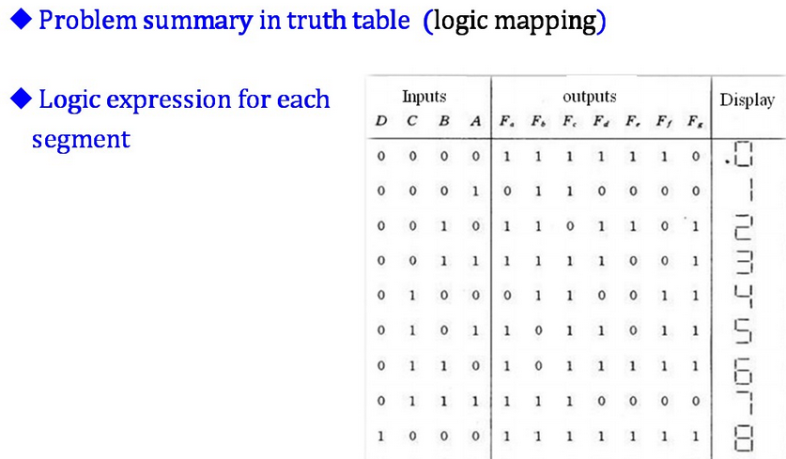
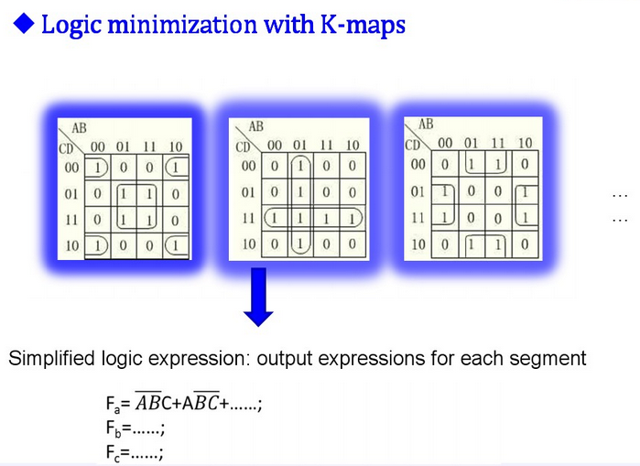
Traditional design

Slide 6
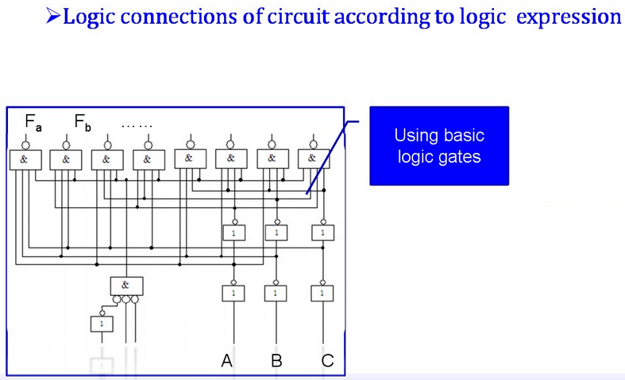
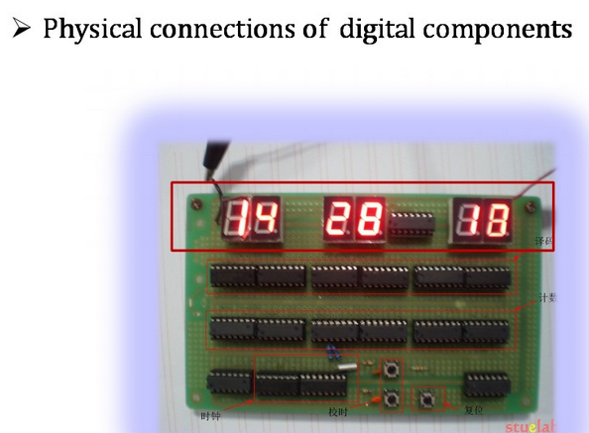
Traditional digital design

Slide 7

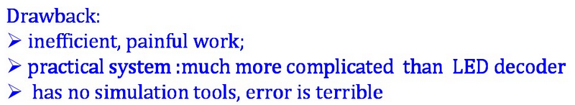
Traditional digital design

Slide 8
Introduction for EDA and Verilog
Chap1.3，1.4
Electronic Design Automation—EDA (电子设计自动化) is a design method developed with appearance of PLD(可编程逻辑器件) devices.
computer aided design-CAD(计算机辅助设计) →CAM, CAE → EDA
EDA tools
Design entry editor
Simulator
Synthesizer
Router
Down loader

Slide 9
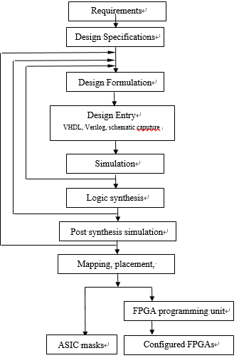

Modern digital design flow
→ Design at conceptual level
→Describe design at behavior/ RTL/ structural level using HDL.
→unveils problems in the initial functional design using testbench
→ convert higher-level abstract description to actual components at the gate and F.F level.
→simulation account for circuit implementations (电路实现) of hardware like timing requirements.
by EDA
HDL & EDA tools use computer automates the most tedious and error-prone aspects of design.
Mapping the design into specific target technology and place into specific parts in the target ASIC or FPGA.
Eg. Writing sequence of 1s and 0s into the programmable cells in FPGA.

Slide 10
Introduce to HDL
HDL: Hardware Description Language.
VHDL
Verilog
leads naturally top-down design methodology
The system is first specified at a higher level →behavior level
Design can be gradually be refined → a structural description closely related to the actual hardware implementation.
Tell it how your circuit should behave and HDL will give you hardware that does the job through a synthesizer.
HDL is target technology independent.

Slide 11
VHDL vs. Verilog
Government Developed in 1981 | Commercially Developed in 1985
Ada based | C based
Strongly Type Cast | Mildly Type Cast
Case-insensitive | Case-sensitive
Difficult to learn | Easier to Learn
HDLs is a HARDWARE!
They are quite different with the tradition program language!
Notes:
VHDL
Commissioned in 1981 by Department of Defense; now an IEEE standard
Initially created for ASIC synthesis
Strongly typed; potential for verbose code
Strong support for package management and large large designs
Verilog
Created by Gateway Design Automation in 1985; now an IEEE standard
Initially an interpreted language for gate-level Simulation
Less explicit typing (e.g., compiler will pad arguments of different widths)
No special extensions for designs

Slide 12
VHDL vs. Verilog
Verilog
LIBRARY IEEE;
USE IEEE.STD_LOGIC_1164.ALL;
USE IEEE.STD_LOGIC_UNSIGNED.ALL;
ENTITY adder8 IS
…………….
END adder8;
ARCHITECTURE one OF adder8 IS
SIGNAL ……;
BEGIN
PROCESS(……)
BEGIN
……………
END PROCESS;
PROCESS(……)
BEGIN
……………
END PROCESS;
END one;
VHDL
module adder8 (
input …… ,
output ……….
);
wire …… ;
always@(……)
begin
……………
end;
always@(……)
begin
……………
end;
endmodule

Slide 13
TOP-DOWN Design
Digital circuit
Top-level module
port-function
PART 3
(sequential
FSM)
PART 1
(combination)
module
port-function
Interconnect
module
port-function
PART 2
(combination)
PART N
(sequential
FSM)
……
module
port-function
module
port-function

Slide 14
Basic Verilog Modeling
Module is a most basic building block of a design. Every component defined in Verilog starts with the keyword module followed by the name of the module and ends with the keyword endmodule.
port declarations describes the input and output ports which serve as the interface beewtteen the component and the outside world.
Interconnect declarations describes the signals interconnect the gates inside of the module, and these signals can’t be seen from the outside.
circuit functionality describes an implementation of the corresponding module.
port_mode port_name1;
port_mode port_name2;
…………
module module_name (port_name1,_port_name2, …);
wire interconnect_name1;
wire interconnect_name1;
…………
port declarations
assign statements;
always @(sensitive signals list)
begin
functionality code
end
Interconnect declarations
circuit functionality
endmodule

Slide 15
Basic Verilog Modeling
module name
module ports
module Multiplexer (w，a, b, s );
output reg w;
input a，b，s;
wire m;
assign m = a+b;
always @(a, b, s)
begin
if (s) w = b;
else w = m;
end
endmodule
The signal assigned in always block should be ‘reg’ type
reserved words
(保留字)
lowercase
Declare port and inter-connect signal
Continuous Assign （连续赋值）statement is used if the unit is simple and combinational.
Process Block(always) statement with sensitivity list (敏感信号列表)is used when the unit is complex.
Notes:
Internal signals such as m here can’t be used outside this module but can be seen in simulation.

Slide 16
Basic Verilog Modeling
Combinational circuits constantly reacts to input changes. Verilog use continuous assign to model concurrent combinational circuits.
Both continuous assign and process block statements are concurrent.
Concurrent statements(并发语句) are statements always ready to execute. The concurrent statements are executed whenever a signal on the right side of the statements changes. The order of concurrent statements is not important.
module Multiplexer (
input a，b，s，
output reg w
)；
module Multiplexer (w，a, b, s );
output reg w;
input a，b，s;
wire m;
assign m = a+b;
always @(a, b, s)
begin
if (s) w = b;
else w = m;
end
endmodule
Semicolon
// Continuous Assign（连续赋值）statement, executed concurrently with other statements
// process block (过程块语句), executed sequentially inside and concurrently outside
No Semicolon
Notes:
The execution of assign statement and always statement has nothing to do with their orders in the HDL codes.

Slide 17
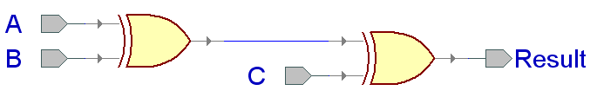
Verilog Design Styles
Chap3.6
Structural level is the lowest level. Designing at this level you need manually finish the design first and then instantiate(实例化) the built in gates of Verilog and specify the interconnections of gates. Synthesizer will give you a circuit exactly the same with your manual design.
When designing circuits at the behavioral level, we do not need to know what logic gates are needed or how they are connected together. We only need to know their interface and functional operation, and then describe it using concurrent (并发) and sequential (顺序) statements. Having written the behavioral code, a synthesizer can automatically construct the circuit that will operate according to the description of the code.
Design at the Dataflow level the circuit is defined using signal-assign statements and built-in logic operations(&, I, ~…) to describe the logic equations of the circuits.
module dataflow (A, B, C, Result);
input A, B, C;
output Result;
assign Result = (A ^ B) ^ C;
endmodule
module behavioral (A, B, C, Result);
input A, B, C;
output reg Result;
always @ (A, B, C)
begin
Result = (A ^ B) ^C;
end
endmodule
module structural (A, B, C, Result);
input A, B, C;
output Result;
wire U1_OUT;
xor U1(U1_OUT,A,B); xor U2(Result,U1_OUT,C);
endmodule
U1_OUT
I1
I1
Y
Y
I2
I2

Slide 18
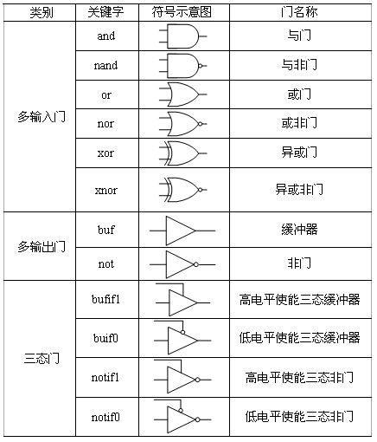
Instantiation (实例化) of the built in gates
gate name <instantiation name>（output，input1， input1 2， input1 3...）
and a1(out,int1,int2,in3);
// 3-input AND gate
bufif1 mytri1(out,in,enable);
//active-high tri-state buffer

Slide 19
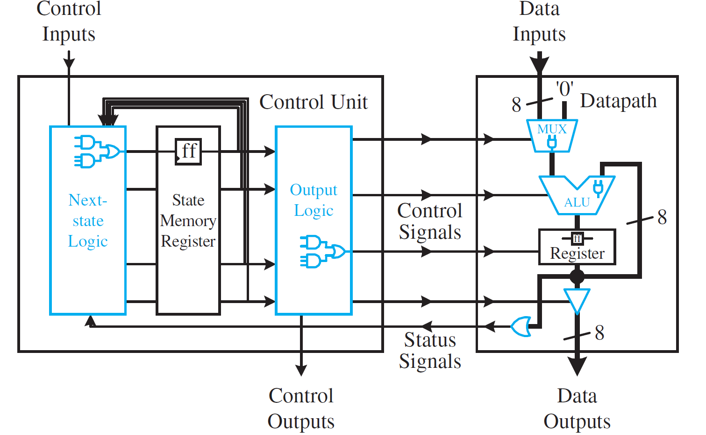
Organization of Center Processor Unit
Parity Generator
Parity Checker
Decoder

Slide 20
Verilog Examples for Combinational Circuit
Multiplexer
Adder & Subtractor
ALU
Decoder/Encoder
Interconnections
Chap1.3，1.4，4.2

Slide 21
2-input, 8-bit MUX
8
data₀
0
8
8
bus1
data₁
1
sel
module Mux8 (
);
endmodule
input sel,
input [7:0] data1, data0,
output[7:0] bus1
assign ;
bus1 = sel ? data1 : data0
// “? : ” is the Conditional operator(条件操作符)，it has the lowest precedence. with assignment (=) it can do assignment for either true or false condition.
Signal=condition ？true_expression：false_expression
Notes:
条件操作符用于2分支的操作比较直观简单，如果条件判断结果为多分枝，用嵌套的条件操作符也可以实现，但是可读性很差，书写时也容易出错。

Slide 22
3-to-1 MUX
module Mux31a ( q, a , b, c, sel ) ;
endmodule
— behavioral Verilog
output q;
input a, b, c;
input [ 1:0 ] sel;
branch expression
（分支表达式）
always @ ( * )
begin
end
reg q; // q is assigned in a process block
// execution inside of a block is sequential(顺序执行)
Control expression
（控制表达式）
always @ ( * )
begin
end
if ( sel[0] == 1 ) q = b;
else if ( sel[1] == 1 ) q = c;
else q = a;
// else is not necessary when all conditions have
been included
case ( sel )
endcase
//Multi-conditional branch statement
(多条件分支语句)
// Conditional statements (条件语句) used for process control.
0: q = a ;
1: q = b;
2: q = c;
default: q = a;
// assign when sel=‘11’;
default is necessary when the match between condition and possible alternatives are not complete.
HARDWARE!
a
0
a
0
1
2
No priority
0
b
c
q
Priority!
c
q
1
b
1
2
sel[1]
sel
sel[0]
Notes:
If else语句中，sel=01和11时，q=b；sel=10时，q=c；sel=00时，q=a；
而case语句中，sel=11时，q=a。
由于原设计中未制定Sel=11时的输出，因此在HDL中可以进行任意赋值。
Case语句中，也可以将default的判断和赋值与第一行合并：[0，3： q=a;]

Slide 23
Case VS If (else)
Case multi-conditional branch statement (多条件分支语句) | If (else) conditional statements (条件语句) used for process control
Sequential statement → matching detection is done from top to bottom | Sequential statement → Logical judgment is done from top to bottom
Multiple branches compare with one common control expression | Check the truth or false of a series of different expressions
Parallel behavior when branches are mutual exclusive(互斥）→ no priority serial behavior when branches overlaps → priority | Serial behavior→ priority
faster, larger area | Slower, smaller area
Synthesizer integrates case statements into multiplexers
Use case to implement table lookup (查表操作)
Notes:
1. 一般来说，如果判断的条件只是一个向量的不同值，那么case是最合适的；如果判断的条件是许多不同的向量或者变量，那么if更合适；当然也可以选择case和if的组合，这样灵活性和时序都比较好。
2. 一般认为case语句对应的电路结构是并行的，即不同分支条件的检测和判断没有优先级。实际上，根据分支中控制表达式所描述的条件之间是否具有互斥性，才能判断case语句对应的电路结构是否具有优先级。若不同分支的条件是互斥的，则无优先级。若分支中的条件有重叠，则由于case语句是顺序语句，依赖于分支在case内部的排列顺序，也会综合出具有优先级的电路结构。
例如将例中的case语句写为：
case( sel[0])
0:q=a;
1:q=b;
Endcase
这种写法，输入sel=00和10时，q=a,则输入c被屏蔽，输入a优先级更高。sel=01和1时，q=b，这条没问题。
3. 为了避免综合出有优先级的电路，case语句的分支条件最好写成互斥的。另外，为了避免综合出一个锁存器，case语句的分支条件应为完备的，可通过添加default语句来简单实现。

Slide 24
Verilog Examples for Combinational Circuit
Multiplexer
Adder & Subtractor
ALU
Encoder/Decoder
Interconnections
Chap4.3，4.5

Slide 25

1 bit Full-Adder
Dataflow Verilog code for 1-bit FA
x
FA
Sum
Sum = X ⊕ Y ⊕ CI
y
Ci
Co / overflow
module fulladder (
);
endmodule
input x, y, ci,
output sum, co
sum = x ^ y ^ ci
assign ;
// ^ is XOR operation
co = (x & y)|(x & ci)|(y & ci)
assign ;
// using ( ) to create good readability

Slide 26
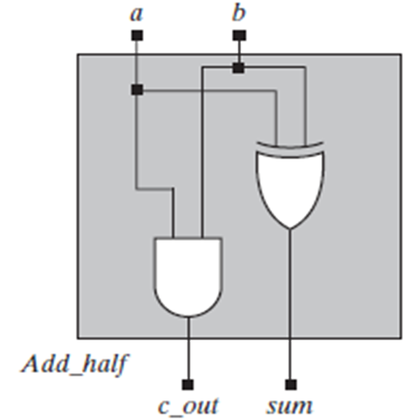
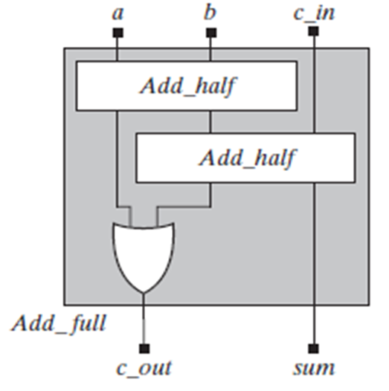
A Full Adder building on Half adders
——structural Verilog code for 1-bit FA
module Add_half (sum, c_out, a, b);
output sum, c_out;
input a, b;
xor (sum, a, b); //
and (c_out, a, b);
endmodule
Defined
Sum = a ⊕ b
Co=a·b
// Primitive Instantiations
(原始实例)
Locations association
(位置关联)
module Add_full (sum, c_out, a, b, c_in);
output sum, c_out;
input a, b, c_in;
wire w1, w2, w3;
Add_half M1 (w2, w1, a, b);
Add_half M2 (sum, w3, c_in, w2);
or (c_out, w3, w1);
endmodule
M1
w1 w2
M2
w3
// internal signals, can’t been seen outside of
the module
// Instantiated（例化）
Name association（名称关联)
M1(.sum(w2), .c_out(w1), .a(a), .b(b))
Instance Names
（例化名）

Slide 27
4-bits Signed Adder
Operator Definition
Precedence high
module Adder4 ( A, B, Cin, S, Cout , Ovout ) ;
endmodule;
input [ 3:0 ] A, B;
input Cin;
output [ 3:0 ] S;
output Cout , Ovout ;
// an overflow is needed to detect the correctness of the addition
assign {Cout, S} = A + B + Cin ;
// {} is cascading operator(拼接符) with the highest precedence
// + is the arithmetic addtion
P125-127→
assign OVout= (A[3]==B[3]) && (S[3] !=A[3]);
assign Ovout = Cout ;
// overflow for unsigned addition is the carry out of the MSB.
// overflow for signed addition occurs when the sign-bit of the 4-bit result is different from the same-signed operands
A
4
Adder4
4
S
B
4
OVout
Cout
Cin
Precedence low

Slide 28
Question： How to design a carry-lookahead Full Adder?
Notes:
A: using dataflow/ structural style

Slide 29
Verilog Examples for Combinational Circuit
Multiplexer
Adder & Subtractor
ALU
Encoder/Decoder
Interconnections
Chap4.6

Slide 30
8-bit ALU
— behavioral Verilog
A
8
8-bit
ALU
8
module ALU8 (
);
endmodule
input [7:0] A, B,
input [1:0] mode,
output reg [7:0] ALUout
8
B
Aluout
mode
2
always @(A, B, mode)
begin
end // end for always
// mode is included in the sensitive list (敏感信号列
//表)so that the output of ALU changes whenever //this signal changes. When describe combinational //circuits all inputs should be included in this list.
case (mode)
0: ALUout = A + B;
1: ALUout = A - B;
2: ALUout = A & B;
3: ALUout = A | B;
default: ALUout = 8'bX;
endcase
The Declaration of ALUout both as output and reg: Because of assigning it within a Procedural Block(过程块语句).
// 8 bit of binary x which is undetermined value；default is optional when the match is complete.
using blocking assignment(阻塞赋值, “=”) to model combinational circuits in always statement. It update the value of signals on the left side of “=” right after the execution of the assignment.

Slide 31
Verilog Examples for Combinational Circuit
Multiplexer
Adder & Subtractor
ALU
Encoder/Decoder
Interconnections
Chap4.7

Slide 32
4-2 Encoder
module Code42( F, I ) ;
endmodule
, en);
output [ 1:0 ] F;
input [ 3:0 ] I;
input en;
reg [1:0] t;
assign F = t ；
en ? t : 2’bz;
// z: High impedance
I₀
always @ ( I )
begin
end
I₁
F1
always @ ( I )
begin
if (I[3]) t= 2’b11 ;
else if (I[2]) t = 2’b10 ;
else if (I[1]) t = 2’b01 ;
else t = 2’b00 ;
end
I₂
F0
case ( I )
1: t = 0 ;
2: t = 1 ;
4: t = 2 ;
8 : t = 3 ;
default: t = 0 ;
endcase
I₃
en
No priority
Priority!

Slide 33
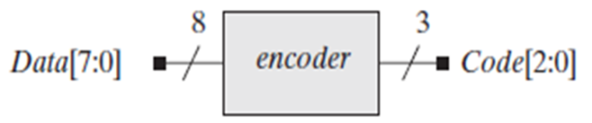
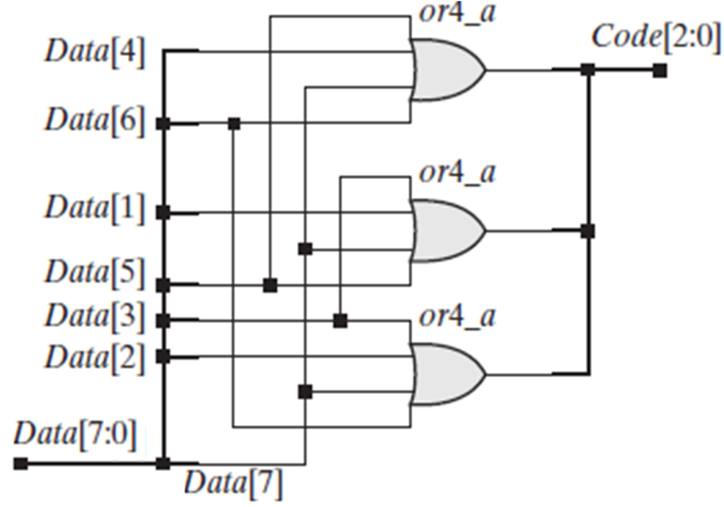
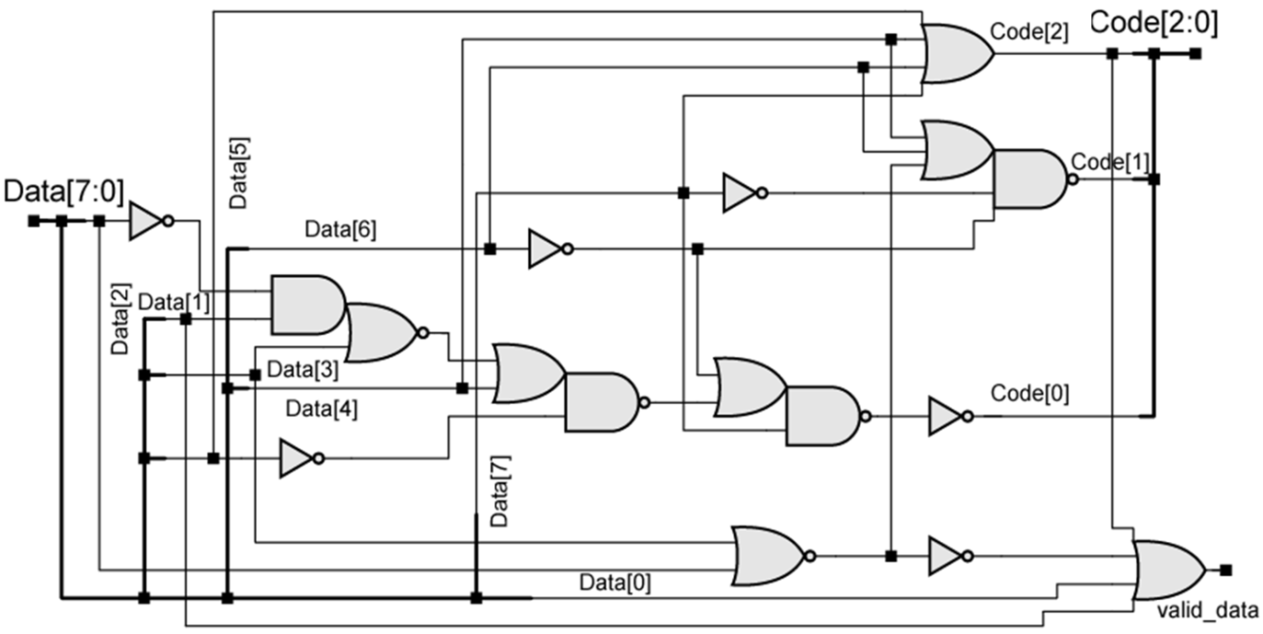
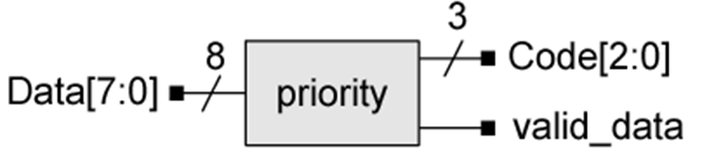
The synthesis results

Slide 34
Verilog Examples for Combinational Circuit
Multiplexer
Adder & Subtractor
ALU
Encoder/Decoder
Interconnections

Slide 35
Interconnections
module ALU8 (input [7:0] left, right,
input [1:0] mode,
output reg [7:0] ALUout );
……..
endmodule
Defined
module Mux8 ( input sel,
input [7:0] data1, data0,
output[7:0] bus1 );
……..
endmodule
Defined
Defined Port
Real connection
ALU8 U1 ( .left(Inbus), .right(ABinput),
.mode(Function), .ALUout(Outbus) );
Mux8 U2 ( .sel(select_source), .data1(Aside), .data0(Bside), .bus1 (ABinput));
Name association
（名称关联)
Locations association
(位置关联)
Ordered Port Connection
ALU8 U1 ( Inbus, ABinput, Function, Outbus );

